Slide 1

Web Development
1
Professional Communication Presentation
Ajay Johny
CSE A
Roll no : 7

Slide 2
Contents
2
What is web development
Languages for web development
Web development softwares
Stages in web development
Types of web developers
Trends in web development
How to become a good web developer

Slide 3

What is web development ?
3
Web development is the work involved in developing a website
It is the building and maintenance of websites
It is done by using a variety of coding languages
This Photo by Unknown Author is licensed under CC BY

Slide 4
Languages Used .
4
HTML makes up the layout and structure for your website
CSS is the language developers can use to style a website
Java is the most popular web programming language

Slide 5
Some web development softwares :
5
Wordpress
Mockplus
Macaw
Adobe Dreamweaver

Slide 6
Stages of web development
6
Information gathering
Planning
Design
Content writing
Coding
Testing , Review and Launch
Maintenance

Slide 7
Types of Web Developers
7
Web developers can be mainly classified into three types:
Front End Developer
Back End Developer
Full Stack Developer

Slide 8
Front End Developer
8
Front end developers are responsible for creating the look and interactive component of a website .
How text , images , and colors are displayed on a website when we see them on mobile or a computer is what a frontend developer creates.
Generally frontend developers use following languages :
HTML
CSS
JavaScript

Slide 9
Back End Developer
9
Back End Developers are responsible for keeping the website running and functioning properly
A back end developer writes what is called Server side code
They can program in a variety of languages depending on what needs to be done

Slide 10
Full Stack Developer
10
Full stack developers can program and work on both front end and back end parts of a website
They tend to have knowledge in multiple programming languages

Slide 11
Trends in web development
11
Web development is a dynamic field.
With the emergence of new technologies each year, we can observe web development trends changing to a greater or lesser extent.
In 2021 too, new technologies have emerged and web developers will try to adopt them and reinvent the earlier technologies which they were working on.

Slide 12
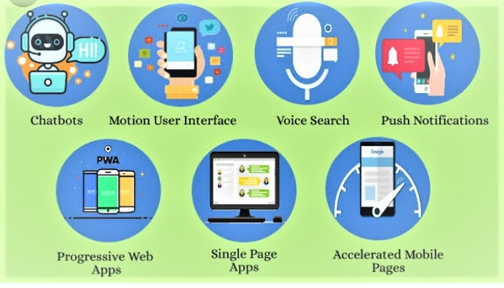
Trends in web development
12

Slide 13
Steps to become a good web developer
13
Learn basics of HTML , CSS , and Javascriprt
Go through WordPress tutorials
Learn basics of UI and UX
practice

Slide 14
Reference
14
Wikipedia
Youtube
https://youtu.be/dwrZbO_DlQI

Slide 15
Thank you
15

